Slide 1
Joseph Rochelle
Week 1 and 2: Data Visualization Examples

Slide 2
Key Learnings
The Color Wheel online is better than what is in Python so far from viewing MatPlotLib
I may create my own color scheme but matching in Python was odd
Titles on X and Y access
Good Titles that speak for themselves
Very much do not liked pie charts now that I think Knaflic (2015) just conditioned me to it.
I’m not able to add the R Kernel in my work laptop from IT restrictions
Doughnuts in Tableau require 2 pies that then synchronize and that was fun to do.

Slide 3
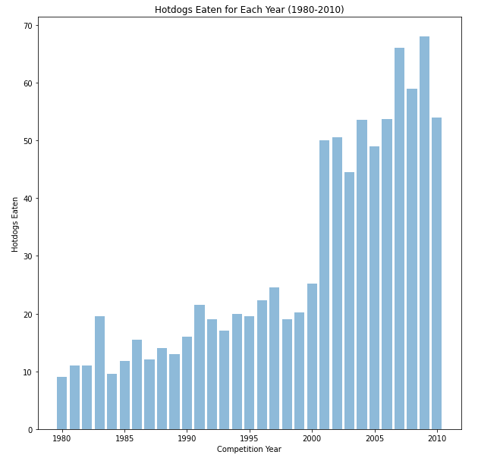
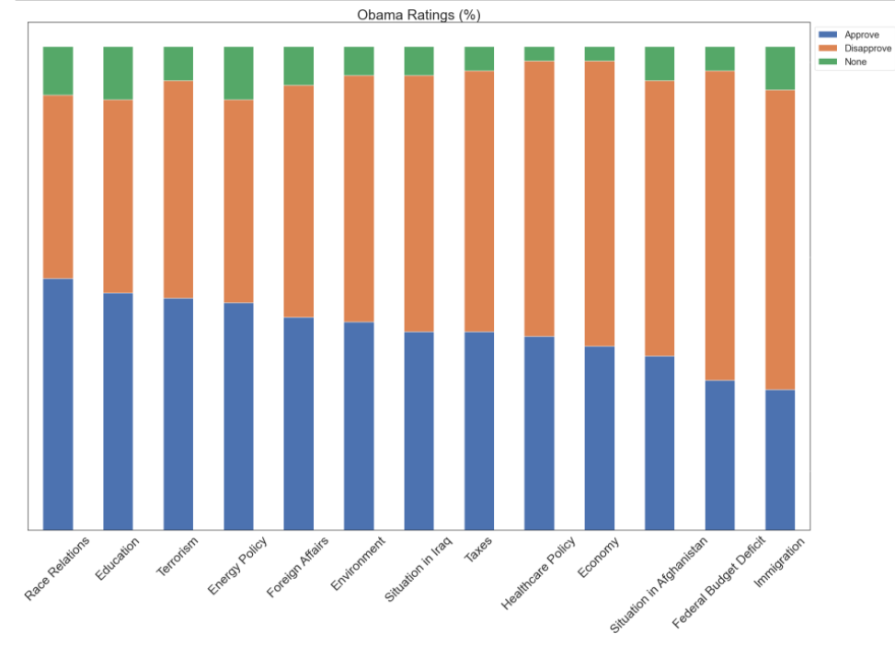
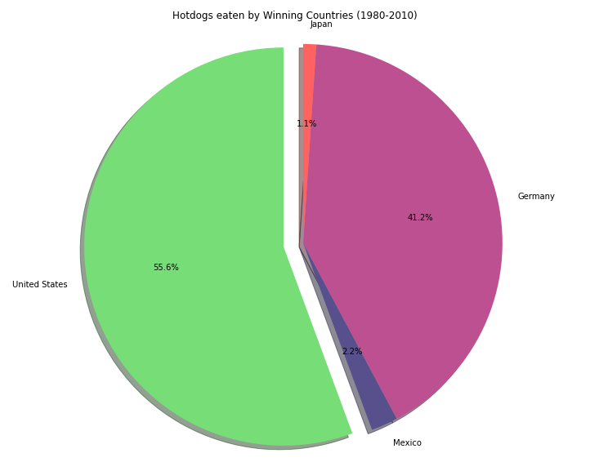
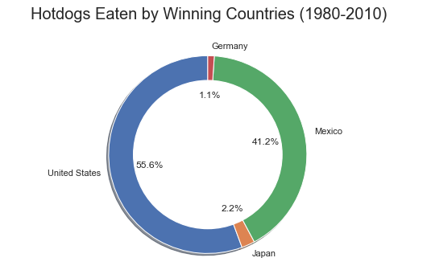
Python

Slide 4
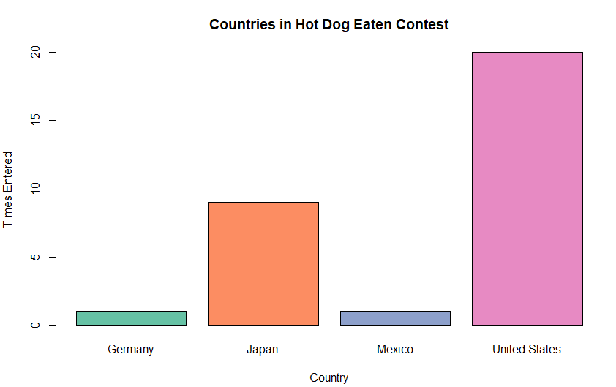
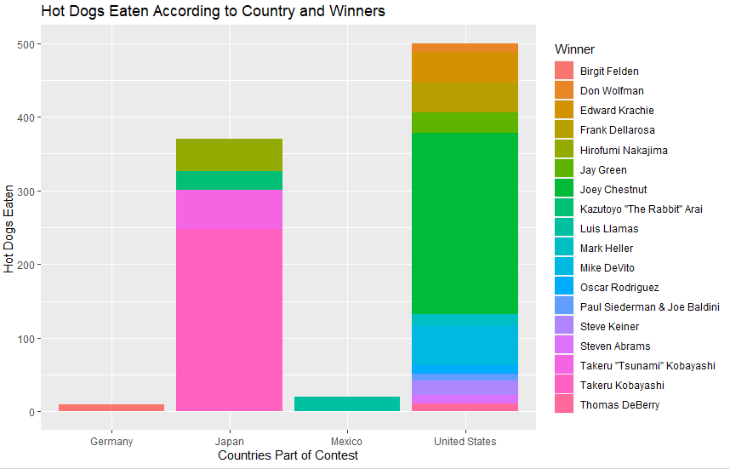
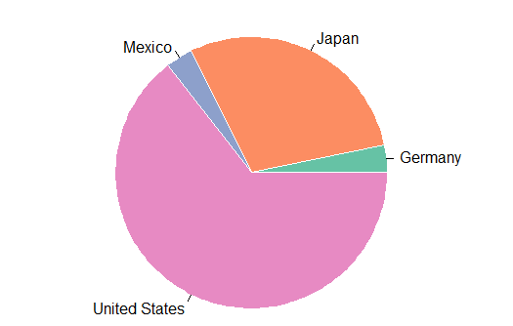
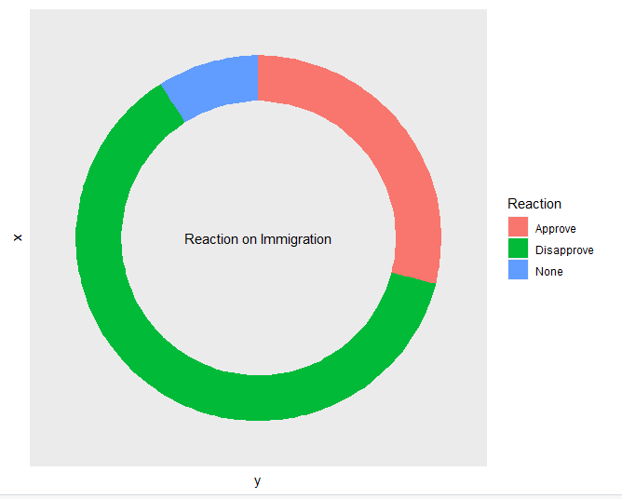
R

Slide 5
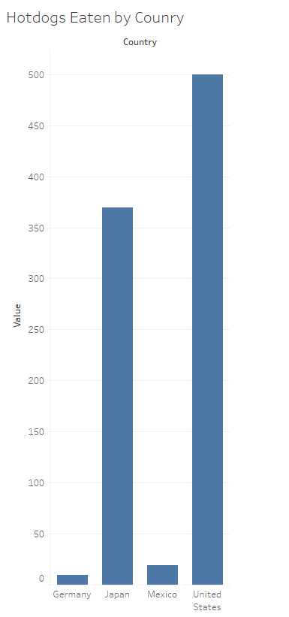
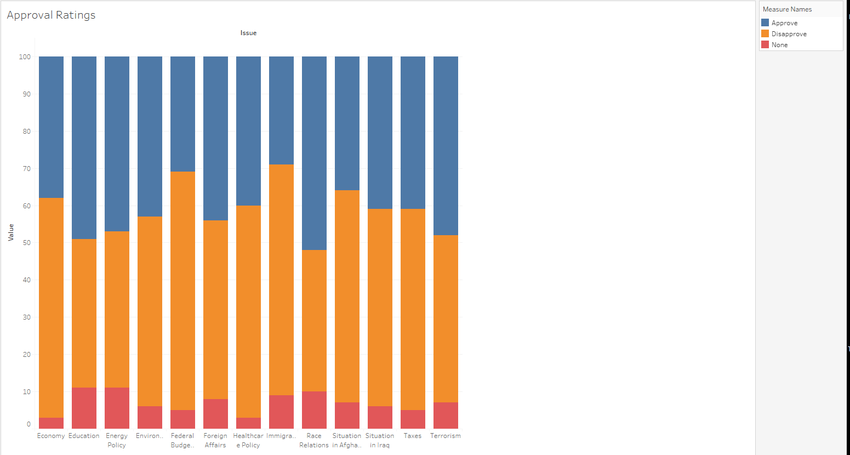
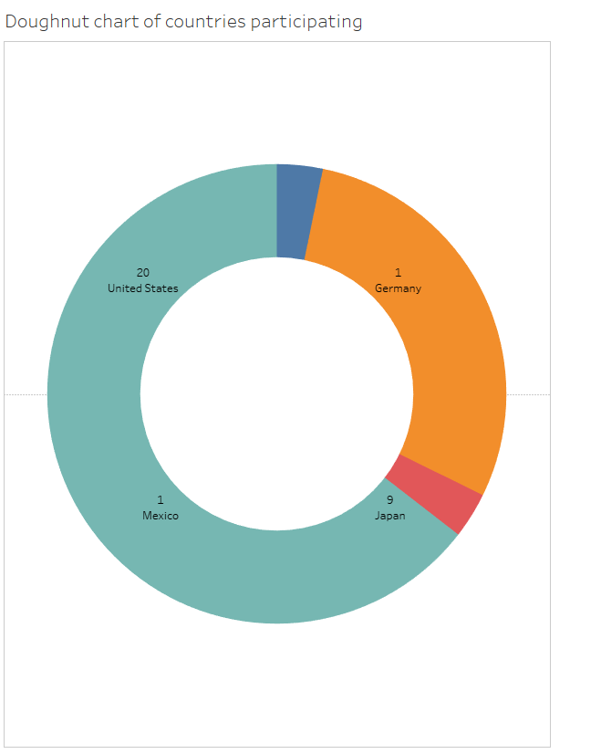
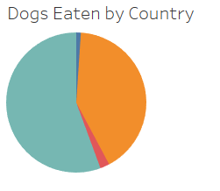
Tableau

